Slide 1

Asymptotic Dynamic Time Warping Calculation with Utilizing Values Repetition
Anooshiravan Sharabiani, Houshang Darabi
Samuel Harford, Elnaz Douzali, Fazle Karim
Hereford Johnson, Shun Chen
University of Illinois at Chicago

Slide 2
The contributions
Presenting BDTW, an algorithm that generalizes the utilization of the repetition of any values in time series to calculate exact DTW for any- two-valued time series, and to calculate a close approximation of DTW for more-than-two-valued time series with repetition of any values.
Presenting a new DTW approximation method for all type of time series based on combination of Adaptive Piecewise Constant Approximation (APCA) OR S1S2 and BDTW method.
We present BDTW Upper Bound as a new upper bound instead of the ED for pruning unhopeful warping alignments of time series with high value repetition rate.
We present BDTW Lower Bound as a new lower bound for pruning unhopeful matches in similarity search of time series with high value repetition rate.
University of Illinois at Chicago

Slide 3
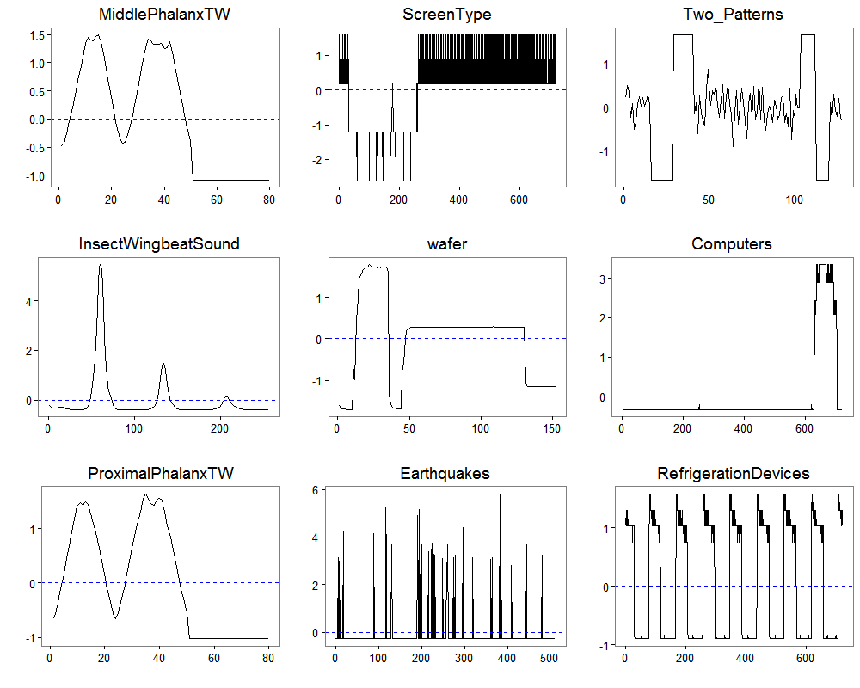
Example of time series with values repetition
University of Illinois at Chicago

Slide 4
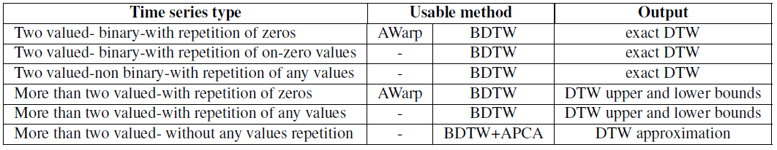
Motivation: Warping Distance for Sparse Time Series
AWarp algorithm approximates DTW on sparse time series:
A. Mueen, N. Chavoshi, N. Abu-El-Rub, H. Hamooni, and A. Minnich, “Awarp: Fast Warping Distance
for Sparse Time Series.” in Data Mining (ICDM) IEEE, 2016, pp. 350–359.
The comparison of the application of AWarp and BDTW
University of Illinois at Chicago

Slide 5
Blocked DTW
Contribution 1
University of Illinois at Chicago

Slide 6

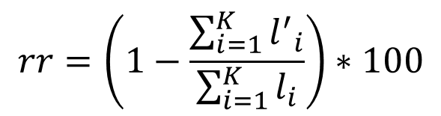
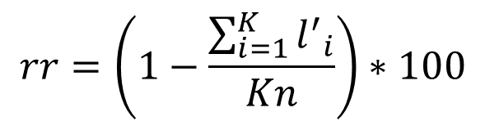
Time Series Length-encoding
T= {1,3,3,2,3,3,3,3,3,1,1,2,2,2,2,1}
TENC ={1(1),3(2),2(1),3(5),1(2),2(4),1(1)}
T= {1,0,0,0,1,0,0,0,1,1,0,0,0, 1}
TENC ={1(1),0(3), 1(1),0(3),1(2),0(3),1(1)}
trr: time series repetition ratio where the original length is l and encoded length is l’
rr: the repetitiveness ratio of a dataset with K time series
rr: the repetitiveness ratio of a dataset with K time series of equal length of n
University of Illinois at Chicago

Slide 7
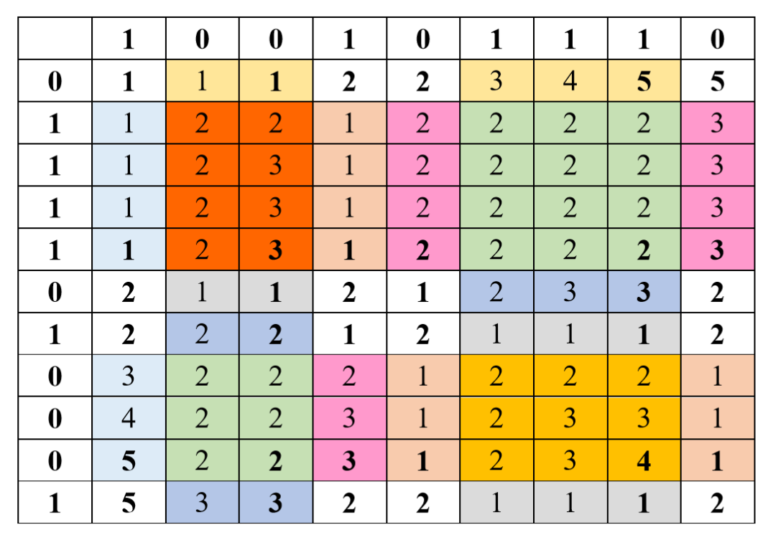
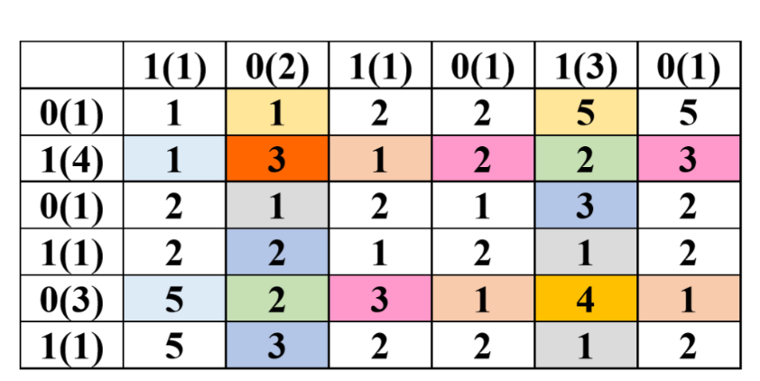
Blocked Dynamic Time Warping
Traditional DTW
D(0, 0) = 0, ∀ ijD(i, 0) = D(0, j) = ∞
Encoding
X={0,1,1,1,1,0,1,0,0,0,1}
XENC={0(1),1(4),0(1),1(1),0(3),1(1)}
Y
Y={1,0,0,1,0,1,1,1,0}
YENC={1(1),0(2),1,0,1(3),0(1)}
Blocked DTW
YENC
X
XENC

Slide 8
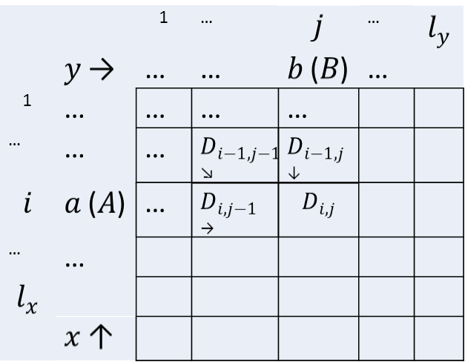
Blocked Dynamic Time Warping
Traditional DTW
Blocked DTW
University of Illinois at Chicago

Slide 9
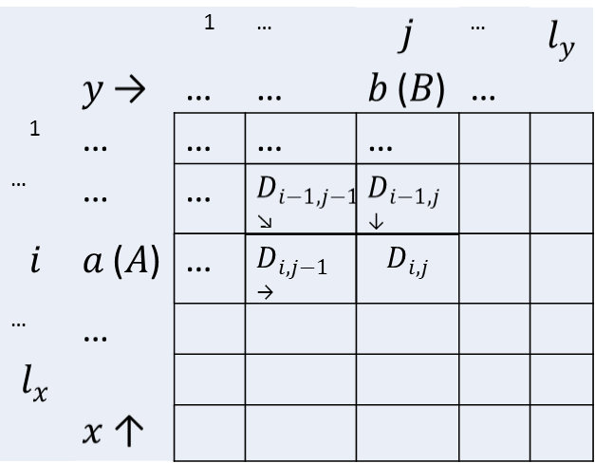
Blocked DTW Algorithm
Required: series1 & series2 ←Encoded time series x & y
Ensure: Output the distance d between series1 and series2
1: l_{x} ← length(series1), l_{y} ← length(series2)
2: D(1:l_{x}, 1:l_{y}) ← ∞
3: D_{1,1} ← (a₁-b₁)²
4: for i ← 2 to l_{x}
5: D_{i,1} ← D_{i-1,j} + A_{i}(a_{i}-b₁)²
6: end for
7: for j ← 2 to l_{y}
8: D_{1,j} ← D_{i,j-1} + B_{j}(a₁-b_{j})²
9: end for
10: for i ← 2 to l_{x}
11: for j ← 2 to l_{y}
12: top ← D_{i-1,j} + A_{i}(a_{i}-b_{j})²
13: diagonal ← D_{i-1,j-1} + max(A_{i}, B_{j})(a_{i}-b_{j})²
14: left ← D_{i,j-1} + B_{j}(a_{i}-b_{j})²
15: D_{i,j} ← min(top, diagonal, left)
16: end for
17: end for
18: return D_{lx,ly}

Slide 10
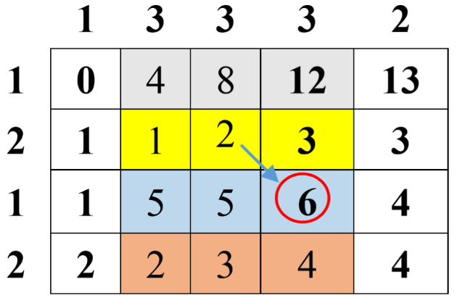
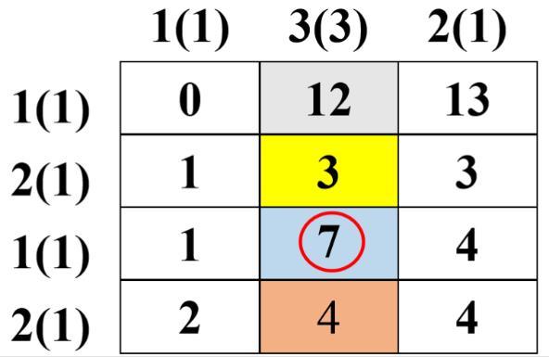

BDTW on More-Than-Two-Valued Time Series with Values Repetitions
University of Illinois at Chicago

Slide 11
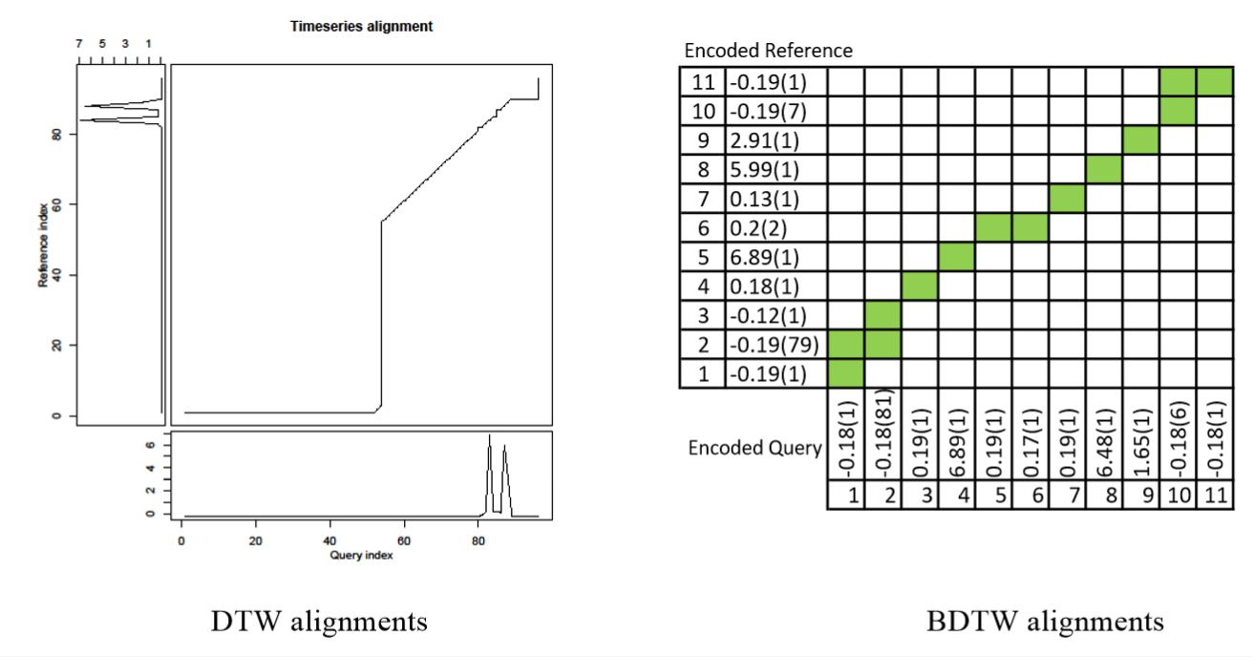
An example of comparison between DTW and BDTW UB alignments
The exact DTW distance is 1.858176
The BDTW distance is 1.858309
University of Illinois at Chicago

Slide 12
Blocked DTW-Lower Bound Algorithm
Required: series1 & series2 ←Encoded time series x & y
Ensure: Output the distance d between series1 and series2
1: l_{x} ← length(series1), l_{y} ← length(series2)
2: D(1:l_{x}, 1:l_{y}) ← ∞
3: D_{1,1} ← (a₁-b₁)²
4: for i ← 2 to l_{x}
5: D_{i,1} ← D_{i-1,j} + A_{i}(a_{i}-b₁)²
6: end for
7: for j ← 2 to l_{y}
8: D_{1,j} ← D_{i,j-1} + B_{j}(a₁-b_{j})²
9: end for
10: for i ← 2 to l_{x}
11: for j ← 2 to l_{y}
12: top ← D_{i-1,j} + A_{i}(a_{i}-b_{j})²
13: diagonal ← D_{i-1,j-1} + max(A_{i}, B_{j})(a_{i}-b_{j})²
14: left ← D_{i,j-1} + B_{j}(a_{i}-b_{j})²
15: D_{i,j} ← min(top, diagonal, left)
16: end for
17: end for
18: return D_{lx,ly}

Slide 13
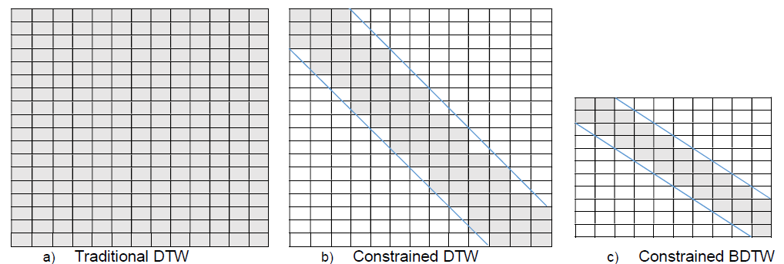
Constrained Blocked DTW
University of Illinois at Chicago

Slide 14
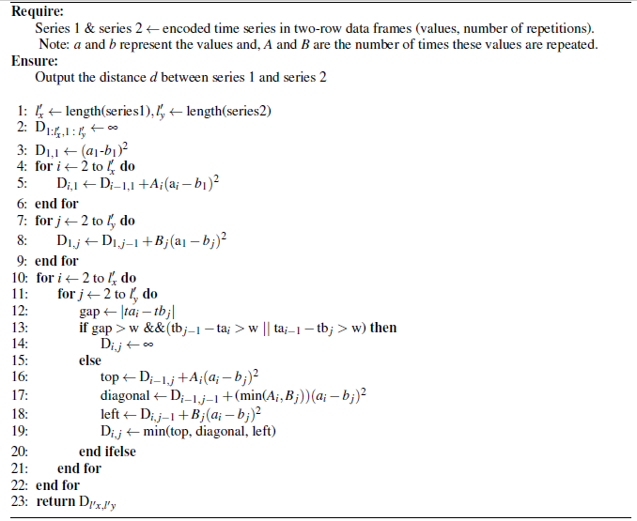
Constrained Blocked DTW Algorithm
University of Illinois at Chicago

Slide 15
Piecewise Constant Approximation Methods+ Blocked DTW
Contribution 2
University of Illinois at Chicago

Slide 16
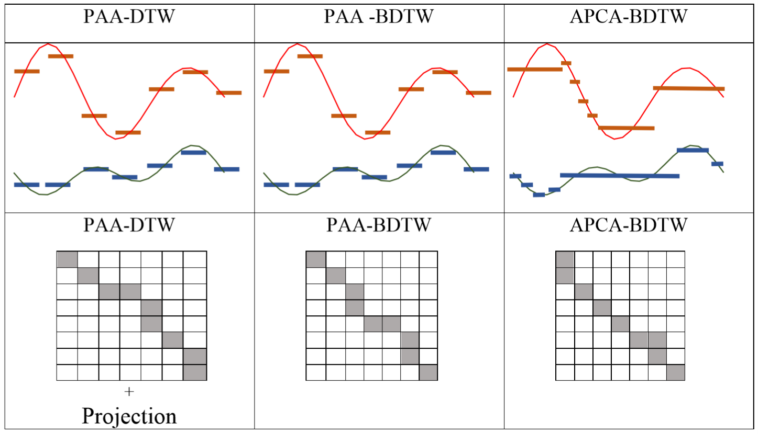
University of Illinois at Chicago

Slide 17
BDTW Upper Bound (BDTW UB)
Contribution 3
A new upper bound which can be used instead of the Euclidean distance (and performs better than it) for pruning unhopeful warping alignments of time series with high repetition rate.
University of Illinois at Chicago

Slide 18


































Upper triangle pruning
UB: ED | UB:BDTW | UB: Exact DTW
University of Illinois at Chicago

Slide 19
BDTW Lower Bound (BDTW LB)
Contribution 4
A new lower bound for pruning unhopeful matches in similarity search of time series with high repetition rate. We show that BDTW LB is competitive with famous lower bound techniques in terms of reduction of processing time in similarity search for time series with high level of value repetitiveness.
University of Illinois at Chicago

Slide 20
Experiments and results
University of Illinois at Chicago

Slide 21
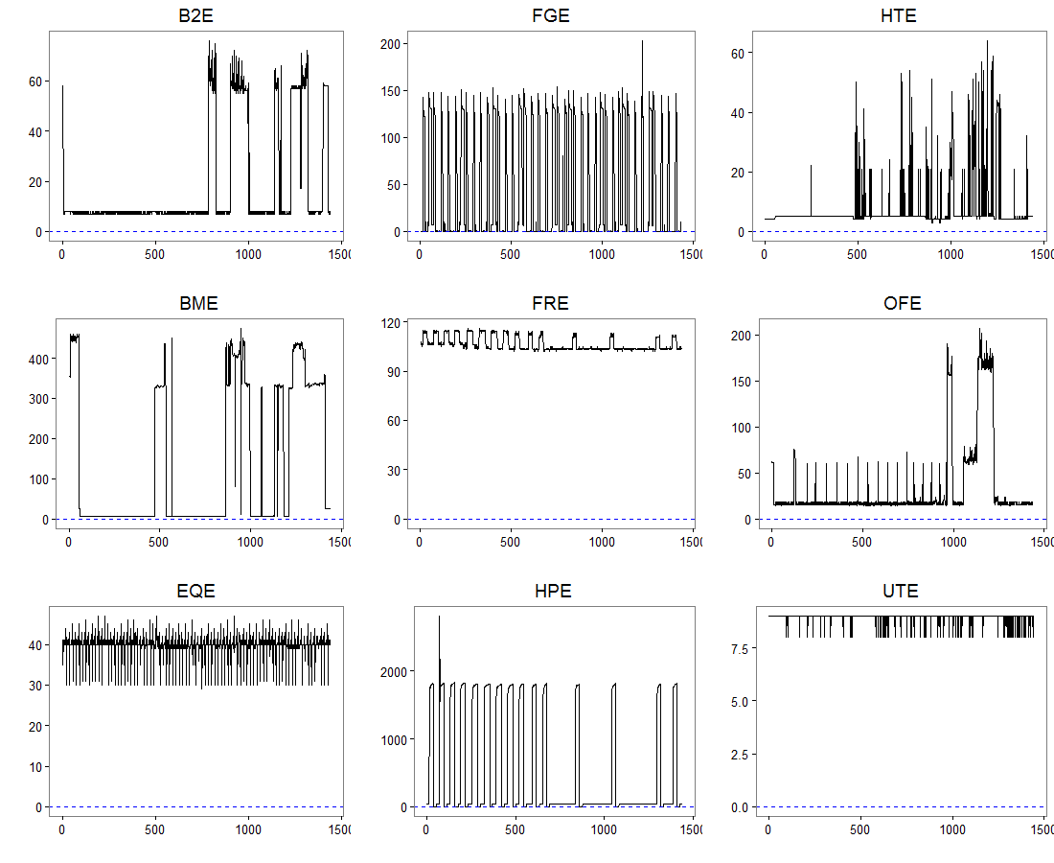
Case study 1
Method | ED Time | DTW | Awarp | BDTW | CDTW | CBDTW
Accuracy | 0.561 | 0.807 | 0.806 | 0.807 | 0.761 | 0.776
Processing time | 51.96 | 8514.20 | 3237.53 | 877.57 | 936.56 | 307.50
University of Illinois at Chicago

Slide 22
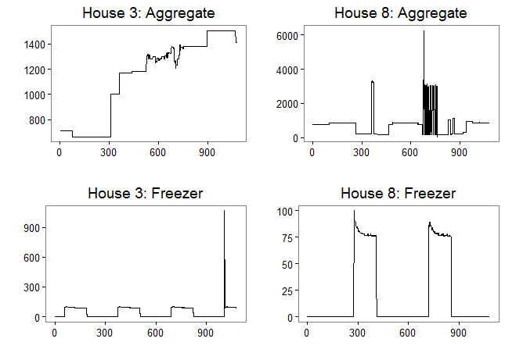
Case study 2
Dataset | Repetition Rate | Method | ED | DTW | Awarp | BDTW | CDTW | CBDTW
HOUSE3,8 Aggergate | 49.80% | Accuracy | 0.87 | 0.90 | 0.90 | 0.90 | 0.89 | 0.87
 |  | Processing time | 5.67 | 143.85 | 174.98 | 57.41 | 71.93 | 33.20
HOUSE3,8 Freezer | 91.13% | Accuracy | 0.64 | 0.86 | 0.86 | 0.86 | 0.73 | 0.77
 |  | Processing time | 17.62 | 1394.83 | 117.23 | 28.76 | 697.42 | 14.95
University of Illinois at Chicago

Slide 23
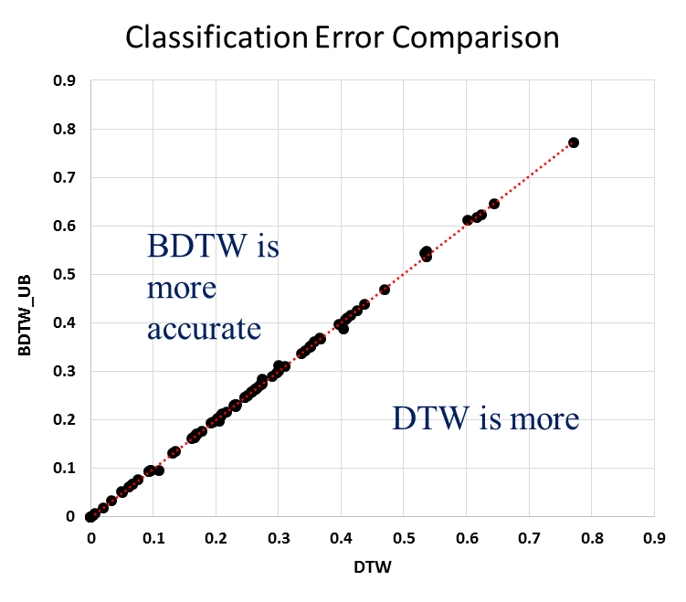
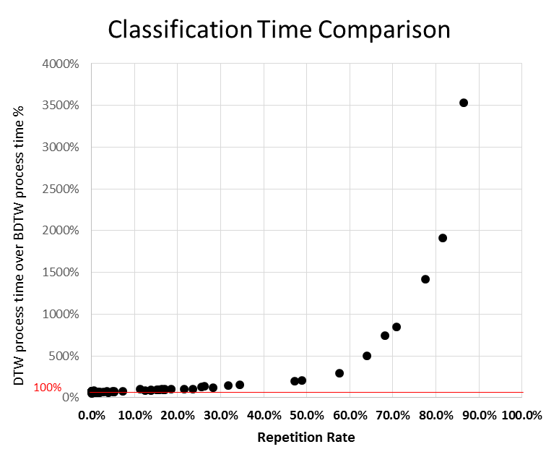
BDTW UB as an Approximation Method of DTW
University of Illinois at Chicago

Slide 24
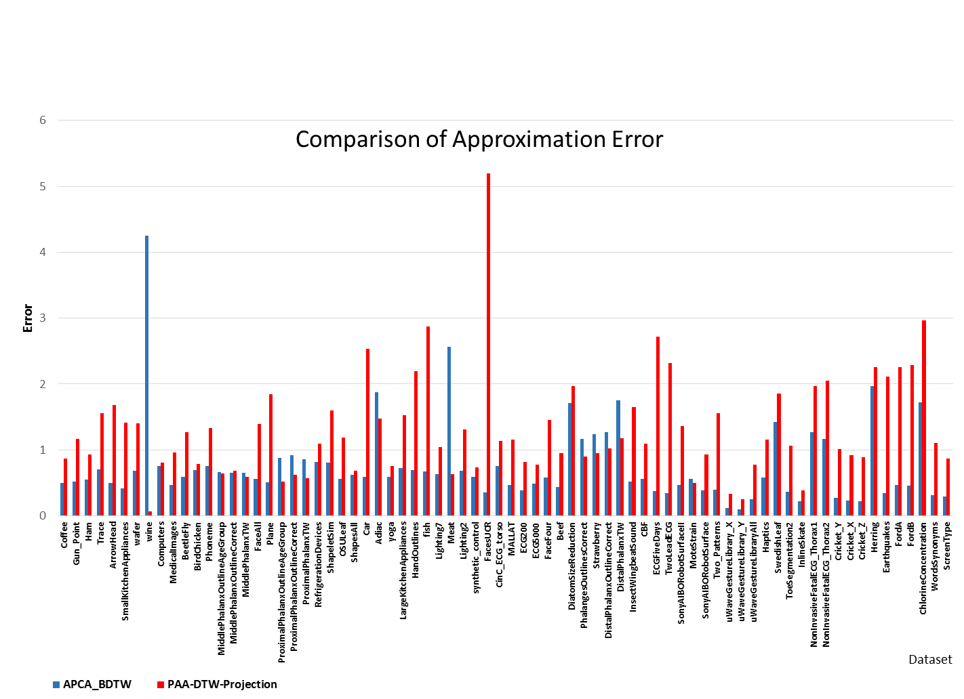
Using BDTW UB on Top of APCA as an Approximation Method for Any-Valued
Time Series
University of Illinois at Chicago

Slide 25

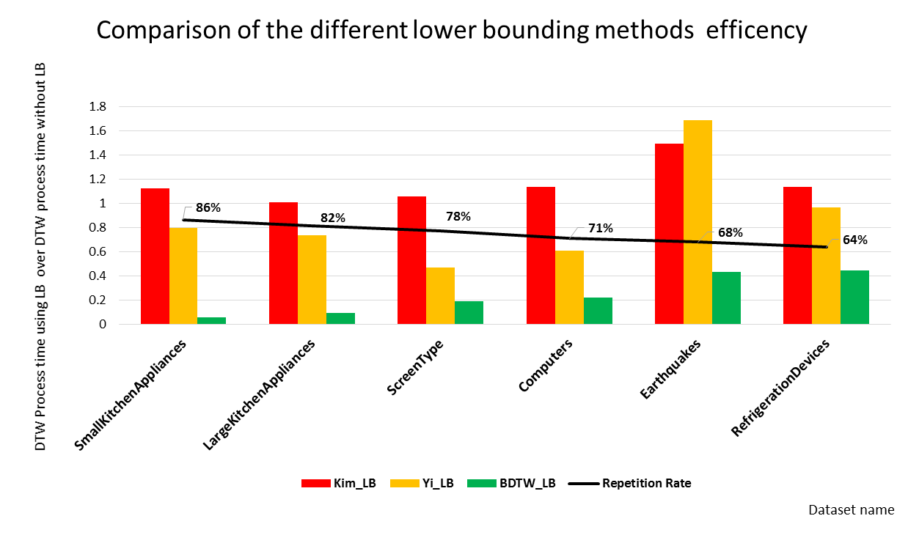
BDTW LB: a New Lower Bound to Increase the Efficiency of DTW
University of Illinois at Chicago

Slide 26
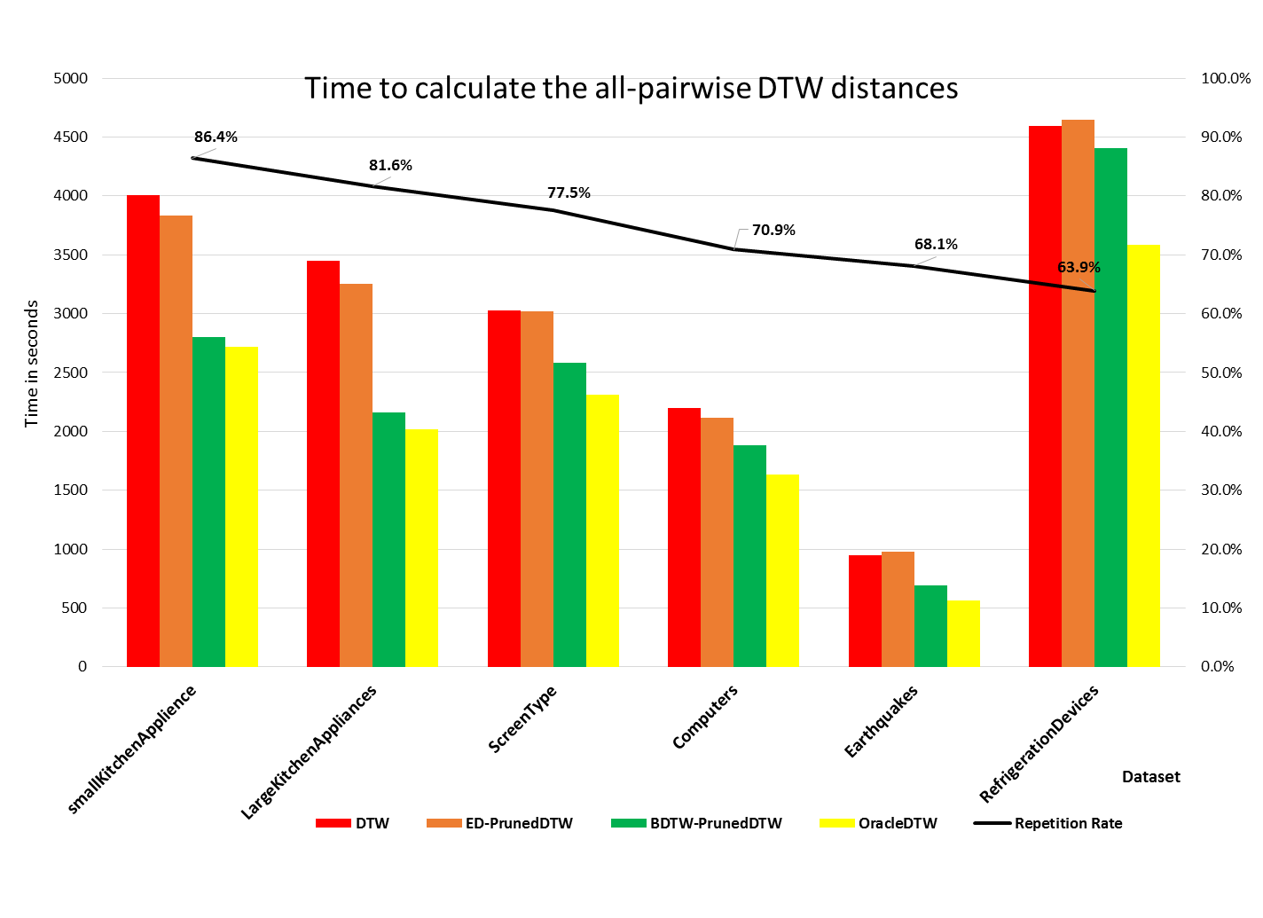
Using BDTW UB as a New Upper Bound to Speed Up All-Pairwise DTW Matrix Calculation
University of Illinois at Chicago

Slide 27
CBDTW LB: Constrained Block DTW
Computers | Repetition Rate | Accuracy |  |  |  | Processing time (s) |  |  |  | CBDTW Speed-up ratio
 |  | DTW-full | CDTW | BDTW | CBDTW | DTW-full | CDTW | BDTW | CBDTW | DTW-full | CDTW | BDTW
SmallKitchenAppliances | 86.4% | 64% | 61% | 64% | 73% | 715.4 | 770.7 | 20.3 | 16.0 | 44.7 | 48.2 | 1.3
LargeKitchenAppliances | 81.6% | 79% | 71% | 80% | 72% | 718.9 | 571.4 | 37.6 | 22.8 | 31.5 | 25.1 | 1.6
ScreenType | 77.5% | 40% | 43% | 39% | 39% | 647.7 | 514.8 | 45.6 | 27.7 | 23.4 | 18.6 | 1.6
Computers | 70.9% | 70% | 64% | 69% | 65% | 312.9 | 297.5 | 37.1 | 24.7 | 12.6 | 12.0 | 1.5
Earthquakes | 68.1% | 74% | 74% | 74% | 74% | 124.7 | 118.5 | 16.7 | 11.1 | 11.2 | 10.6 | 1.5
RefrigerationDevices | 63.9% | 46% | 46% | 46% | 51% | 758.7 | 1,016.3 | 150.2 | 86.0 | 8.8 | 11.8 | 1.7
ElectricDevices | 57.6% | 60% | 62% | 61% | 64% | 6,172.2 | 4,568.5 | 2,111.5 | 1,087.6 | 5.7 | 4.2 | 1.9
wafer | 48.8% | 98% | 98% | 98% | 100% | 1,120.0 | 375.4 | 543.5 | 278.5 | 4.0 | 1.3 | 2.0
FaceFour | 47.2% | 83% | 83% | 83% | 88% | 2.7 | 3.0 | 1.4 | 0.5 | 5.3 | 5.9 | 2.7
Two_Patterns | 34.4% | 100% | 100% | 100% | 100% | 724.8 | 317.4 | 478.5 | 195.1 | 3.7 | 1.6 | 2.5
uWaveGestureLibrary_Y | 31.8% | 63% | 66% | 63% | 70% | 2,496.3 | 967.2 | 1,686.3 | 740.1 | 3.4 | 1.3 | 2.3
uWaveGestureLibraryAll | 28.2% | 89% | 89% | 91% | 95% | 26,655.0 | 28,464.3 | 22,290.9 | 13,844.7 | 1.9 | 2.1 | 1.6
uWaveGestureLibrary_X | 26.2% | 73% | 74% | 73% | 80% | 2,688.6 | 1,064.9 | 1,932.7 | 850.1 | 3.2 | 1.3 | 2.3
uWaveGestureLibrary_Z | 25.6% | 66% | 67% | 66% | 70% | 2,335.6 | 925.1 | 1,774.9 | 780.6 | 3.0 | 1.2 | 2.3
University of Illinois at Chicago

Slide 28
Conclusion
Blocked Dynamic Time Warping (BDTW) utilizes values repetition in time series to shrink the size of DTW matrix for reducing the processing time.
BDTW algorithms obtains an upper bound and a lower bound of DTW.
The Combination of BDTW upper bound and APCA provides a close approximation of DTW distance, even for time series without any value repetition.
BDTW upper bound and lower bound can be used as pruning technique for time series with high value repetition.
Constrained BDTW Algorithm is faster than Constrained DTW with similar or better accuracy for time series with high value repetition
University of Illinois at Chicago

